Slide 1
Special Course in Software Engineering ‘24
MINI-PROJECT PRESENTATION
GROUP NO. 4 Lambda

Slide 2
Group Introduction

Slide 3
Group members and their contribution
Member Name | Contribution to the Mini-project
ZhangShuo Chen | Data analysis &&Combine code
Jia Qu | Data analysis && Overal polish
Jingjun Ma | Data Inspection && Make PPT

Slide 4
Dataset

Slide 5
Dataset introduction
Dataset name: Dietary Habits Survey Datasrt
Brief description: The dataset is a survey of dietary habits, including variables such as age group, gender, meal frequency, diet type, and food preferences. It shows diverse eating habits, dietary consumption trends, meal frequency and patterns, and health awareness.
Variable | Type of data | Mean / Median / Mode | Kurtosis | Skewness | Normality
Age | Nominal | NA/NA/Young people | NA | NA | Not Found
Gender | Nominal | NA/NA/Male | NA | NA | Not Found
Meal Frequency | Ratio | 3.13/3.00/3 | 0.64 | 0.44 | Not Found
Diet Type | Nominal | NA/NA/Non-Vegetarian | NA | NA | Not Found
Skip Meals | Nominal | NA/NA/Rarely | NA | NA | Not Found
Satiety | Nominal | NA/NA/Sometimes | NA | NA | Not Found
Consult Nutritionist | Nominal | NA/NA/Never | NA | NA | Not Found

Slide 6
Dataset introduction
Variable | Type of data | Mean / Median / Mode | Kurtosis | Skewness | Normality
Cooking Frequency | Ordinal | NA/NA/Sometimes | NA | NA | Not Found
Main Meal | Nominal | NA/NA/Lunch | NA | NA | Not Found
Diet Composition | Nominal | NA/NA/Freshly home-cooked produce | NA | NA | Not Found
Eating out Frequency | Ordinal | 1.90/1.50/1 | 3.31 | 1.74 | Not Found
Allergic | Nominal | NA/NA/I do not have any allergies | NA | NA | Not Found
Sweet Food Intake | Ratio | 3.65/3.00/7 | -1.05 | 0.46 | Not Found
Salty Food Intake | Ratio | 6.63/5.50/7 | 2.01 | 1.69 | Not Found
Fresh Food Intake | Nominal | NA/NA/Once a day | NA | NA | Not Found
Fresh Vegetables Intake | Nominal | NA/NA/In every meal | NA | NA | Not Found

Slide 7
Dataset introduction
Variable | Type of data | Mean / Median / Mode | Kurtosis | Skewness | Normality
Oily/Fried Food Intake | Nominal | NA/NA/Few times a week | NA | NA | Not Found
Meat Intake | Nominal | NA/NA/Never | NA | NA | Not Found
Seafood Intake | Nominal | NA/NA/Never | NA | NA | Not Found
Tea Consumption | Nominal | NA/NA/Never | NA | NA | Not Found
Coffee Consumption | Nominal | NA/NA/Never | NA | NA | Not Found
Soft Drink | Nominal | NA/NA/Once a month | NA | NA | Not Found
Fruit Drink | Nominal | NA/NA/Few times a week | NA | NA | Not Found
Dairy Drink | Nominal | NA/NA/Once a day | NA | NA | Not Found
Alcohol | Nominal | NA/NA/Never | NA | NA | Not Found
Water Consumption(cup) | Ratio | 8.58/8.00/8 | -0.26 | 0.64 | Not Found

Slide 8
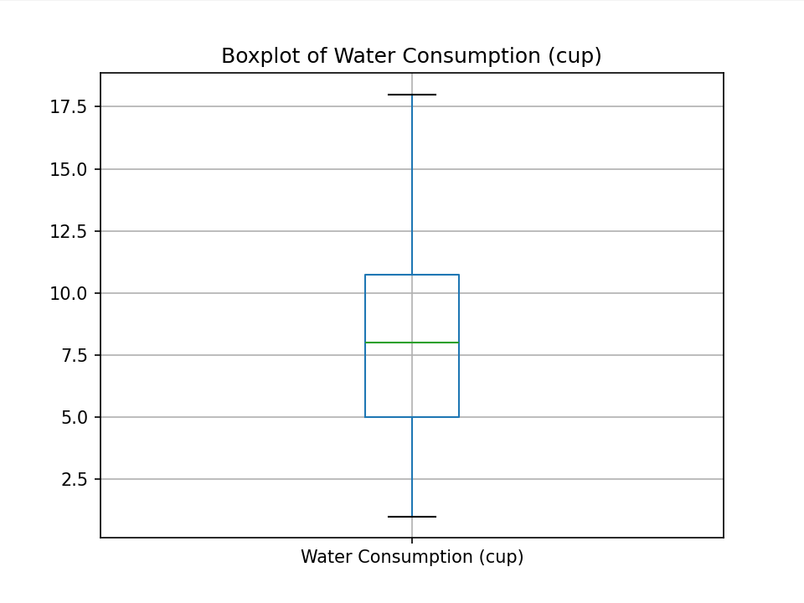
(Water Consumption) distribution #1
Plot Type: Boxplot
Description:
Maxmium: over 17.5, about 18
Minmum: less than 2.5, about 1
Median: about 8 Outliers: NA
Inter Quartile Range: 5-11
A boxplot shows that the distribution of water consumption is relatively concentrated, and the amount of water consumed by most people is concentrated in a stable range each day.

Slide 9
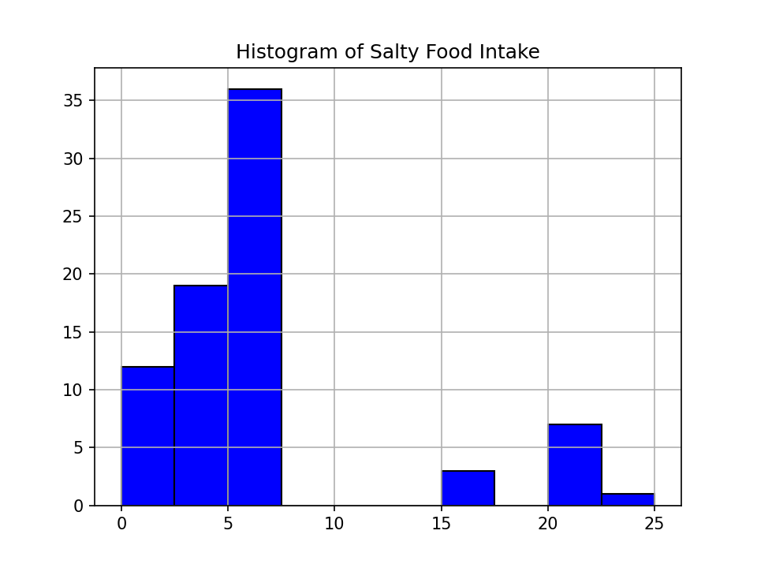
(Salty Food Intake) distribution #2
Plot Type: Histogram
Description:
X-axis (Horizontal): Intervals of Salty Food Intake
Y-axis (Vertical):Frequency of data points in each bin
A histogram shows most people eat less than 7.5 salt servings a week, but a small number of people eat more than 15.

Slide 10
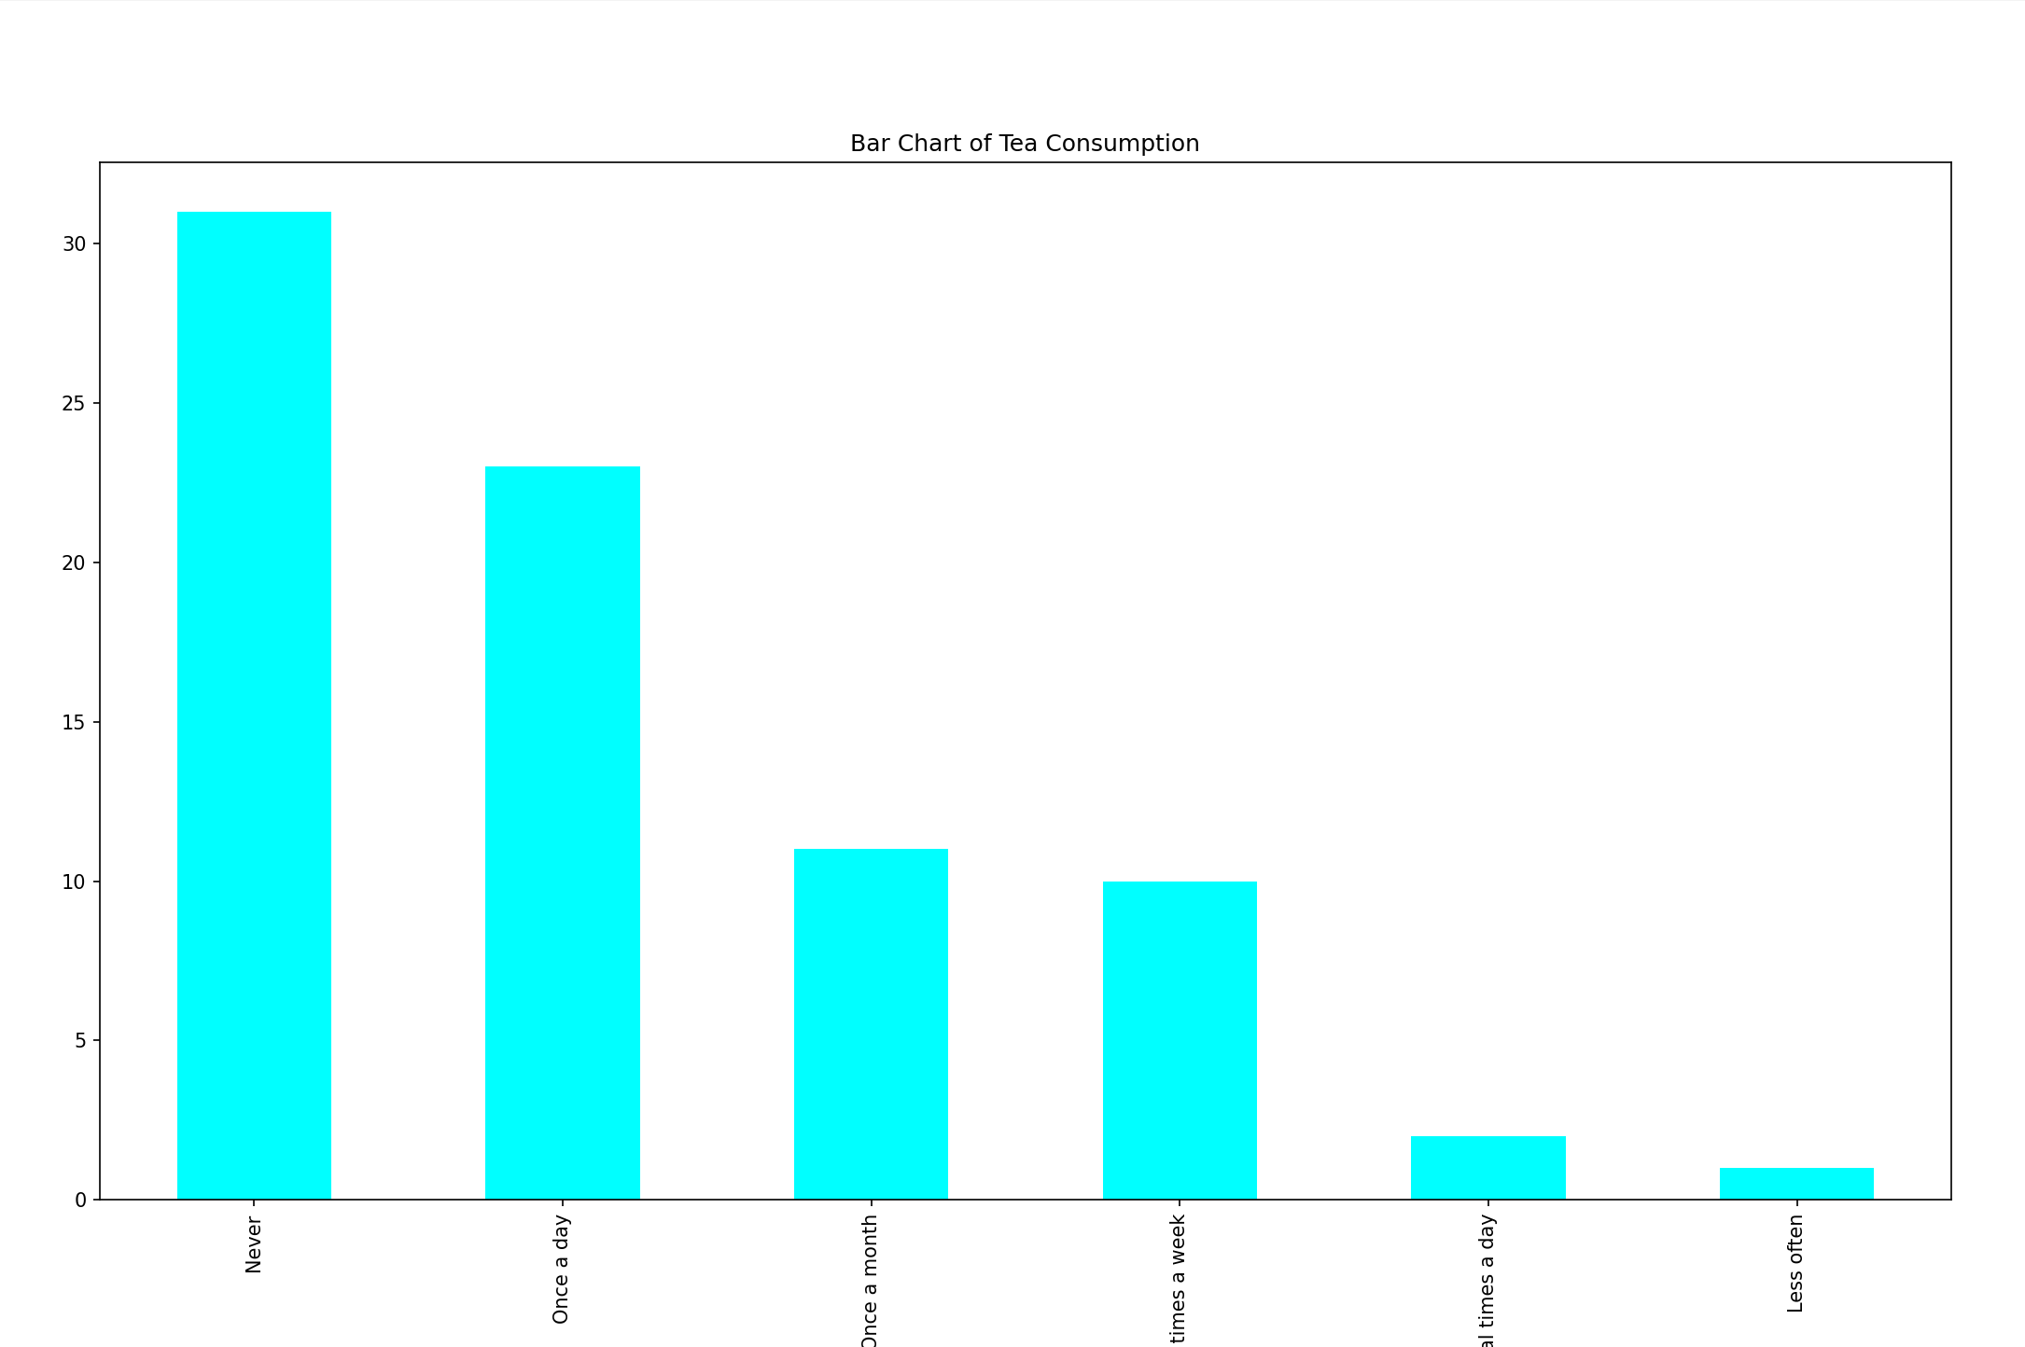
(Tea Consumption) distribution #3
Plot Type: Bar Chart
Description:
A Bar Chart shows the largest proportion of people never drink tea.
More people drink tea once a day.
A few times, a month and a few times a week are relatively small groups.
Groups drinking tea several times a day and less frequently were the least.

Slide 11
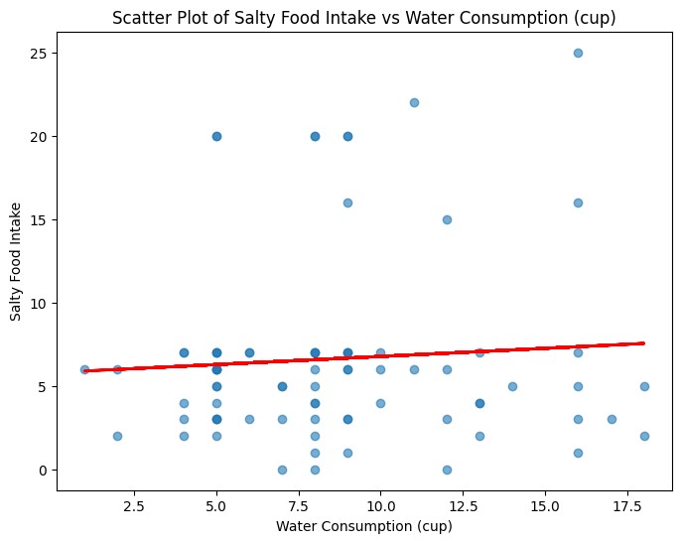
(Salty Food Intake VS Water Consumption) distribution #4
Plot Type: Scatterplot
Description:
A scatter plot shows the relationship between salty food intake and water intake.
It contains a fitting line that shows a slight positive correlation trend: food intake increased slightly with the amount of water consumed.
However, the spread of data points suggests a weak correlation.
Therefore, there was no significant linear relationship between them.

Slide 12
Analysis

Slide 13
Hypothesis #1
Analysis Type: Chi-Square Test
Variables:
Consult a nutritionist(categorical)
Fresh vegetables intake(categorical)
H₀ (Null Hypothesis) :
There is no relationship between consulting a nutrionist and fresh vegetables intake.
H_{a} (Alternative Hypothesis):
There is a relationship between consulting a nutrionist and fresh vegetables intake.

Slide 14
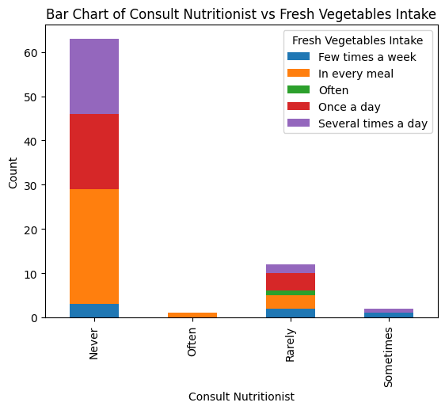
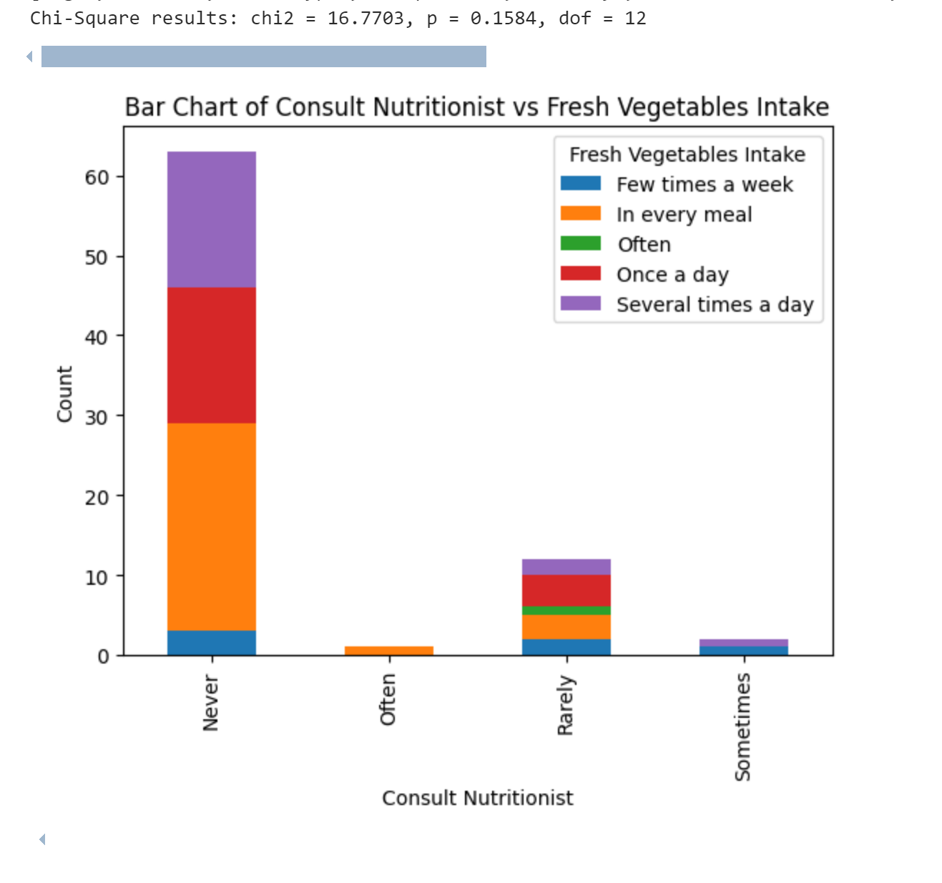
Testing Hypothesis #1
Result Explanation:
A Chi-Square test was conducted to determine if there is a significant association between consulting nutritionist and fresh vegetable intake.
Observed Values: There is no significant relationship between two variables.
Expected Values: There is a relationship between two variables.
Chi-Square Statistic: 16.7703 p-value: 0.1584 Degree of freedom:12
The Chi-Square Statistic is large, indicating a large difference between the observed value and the expected value.
The p-value is greater than 0.05, indicating that there is not enough evidence to reject the null hypothesis.
Above all, there is insufficient evidence to suggest a significant relationship between consulting nutritionist and fresh vegetable intake.

Slide 15
Hypothesis #2
Analysis Type:
Shapiro-Wik Test
ANOVA
Variables:
Water consumption(cup)
satiety
H₀ (Null Hypothesis) :
There is no relationship between water consumption(cup) and satiety.
H_{a} (Alternative Hypothesis):
There is a relationship between water consumption(cup) and satiety.

Slide 16
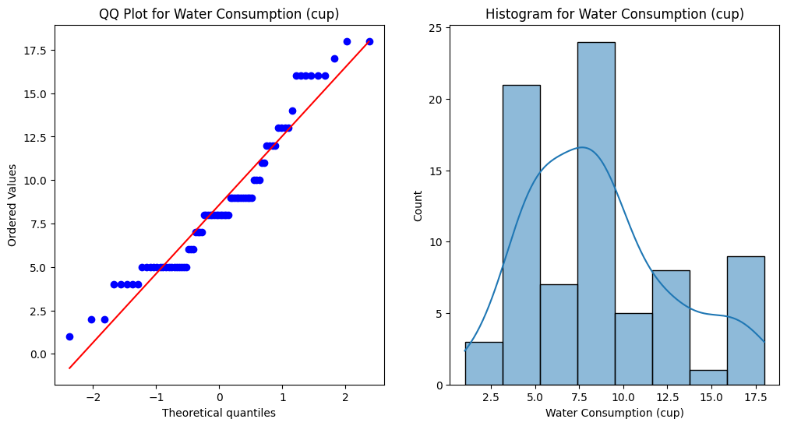
Testing Hypothesis #2
The QQ Plot compares the actual distribution of water consumption data with the theoretical normal distribution.
The data points are almost close to the red diagonal, which indicates that the data may follow a normal distribution.
The histogram shows the frequency distribution of water consumption.
The histogram is higher in the middle and lower on both sides, which may represent a normal distribution.
QQ plot and histogram help determine whether the data conforms to a normal distribution, which is the key to performing Shapiro-Wilk tests.

Slide 17
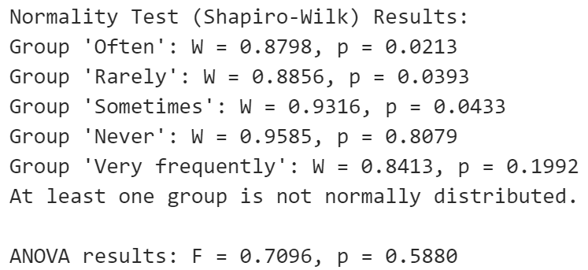
Testing Hypothesis #2
Result Explanation:
The Shapiro-Wilk test is used to test whether the distribution of continuous variables such as water intake conforms to a normal distribution.
ANOVA is used to examine whether there were significant differences in mean water consumption at different satiety levels.
p-value: 0.7096 f-value:0.5880
The f-value is a little low, indicating relatively little difference between the groups.
The p-value is greater than 0.05, indicating that there is not enough evidence to reject the null hypothesis.
Above all, there is insufficient evidence to suggest a significant relationship between water consumption(cup) and satiety.

Slide 18
Hypothesis #3
Analysis Type: Regression
Variables:
Salty food intake
Water consumption(cup)
H₀ (Null Hypothesis) :
There is no relationship between salty food intake and water consumption(cup).
H_{a} (Alternative Hypothesis):
There is a relationship between salty food intake and water consumption(cup).

Slide 19
Testing Hypothesis #3
Result Explanation:
Dependent variable: salty food intake
Independent variable: water consumption
Coefficients: Constant (Intercept): 5.7938 Water Consumption (cup): 0.0973
This coefficient suggests a small, positive relationship between water consumption and salty food intake.
P-values: Constant (P-value): 0.000 Water Consumption (P-value): 0.550
The p-value of 0.550 is much greater than the 0.05 significance level, meaning the relationship between water consumption and salty food intake is not statistically significant.
R-squared: 0.005
This indicates that only 0.5% of the variation in salty food intake can be explained by water consumption, suggesting a very weak relationship.
Since the p-value for the slope (0.550) is greater than 0.05, we fail to reject the null hypothesis.
Conclusion: There is insufficient evidence to suggest a statistically significant relationship between salty food intake and water consumption.

Slide 20
Interesting results
BONUS – 5 points

Slide 21
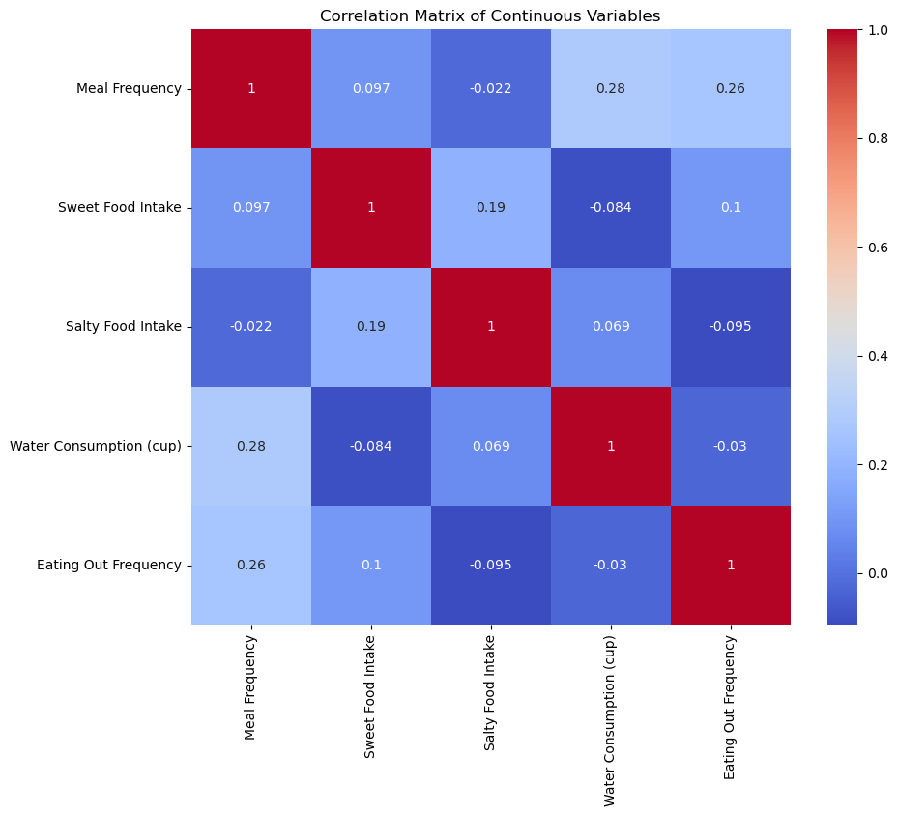
Interesting Hypothesis
According to the correlation matrix of continuous variables,
we can make some interesting hypothesis.
H₀ : There is no relationship between salty intake and eating out frequency.
H_{a} : There is a relationship between salty intake and eating out frequency.
The correlation coefficient between the intake of salty food and the frequency of eating out was -0.095, showing a negative correlation trend.
This could mean that people who eat out frequently consume less salty foods, possibly because foods outside tend to be healthier or choose diets with less salt.

Slide 22
End

